Slide 1

TRAVEL POLICY AND
TRAINING

Slide 2

TRAINING Objective
Travel Policy (PPM49)
Docusign Approval Process
Travel Booking Process
Required Documentation
Helpful tips, questions, and feedback

Slide 3

PURPOSE:
The purpose of this training is to offer guidance on the University’s travel procedures and regulations to ensure compliance with the Office of State Travel. It aims to provide a clear procedural framework for employees and students traveling on university business and to promote responsible fiscal practices in spending.
All University employees are expected to take responsibility when traveling for university-related purposes and to comply with the requirements set forth by the Southern University System. The Chancellor has granted the Vice Chancellor for Finance and Administration the authority to update any provisions in the policy appendix. When appropriate, the Vice Chancellor for Finance and Administration will facilitate the review of proposed policy changes by administrative staff.

Slide 4
MISSION
The mission of the Southern University Travel Department is to ensure that all travel is properly approved and booked in compliance with the guidelines set by the Office of State Travel and Southern University regulations. The department is also committed to providing timely and accurate documentation for travel undertaken by both employees and non-employees on official University business. Additionally, the department offers education and training to SUNO employees regarding the travel regulations established by both the University and the Office of State Travel.

Slide 5
Important Travel References
PPM49- https://www.doa.la.gov/doa/ost/ppm-49-travel-guide
Christopherson Business Travel- https://app.cbtat.com
Toll Free: 800-961-0720
Direct: 205-874-8538 Hours: 7:00 AM - 8:00 PM CT, Monday – Friday
Email: statela@cbtravel.com (State Advisor Team)
Email: statelauniv@cbtravel.com (University Advisor Team
Travel Specialist
Erica M Toca
Southern University at New Orleans
6400 Press Drive
New Orleans, LA 70126
p: 504.286.5151
e: etoca@suno.edu

Slide 6
Understanding the Travel Policy PPM49
Employees should familiarize themselves with the key guidelines outlined in the travel policy. For more detailed information, please refer to the link on the previous slide (PPM49), which covers topics such as:
Eligible travel expenses
Preferred methods for booking travel (e.g., using a corporate travel agency or booking tool)
Travel class options (economy, business, etc.)
The duration and purpose of travel in line with company policies
Compliance: It is essential to ensure that all travel arrangements comply with the guidelines set by PPM49 to avoid issues with reimbursements, non-compliant bookings, or unnecessary approval processes.

Slide 7
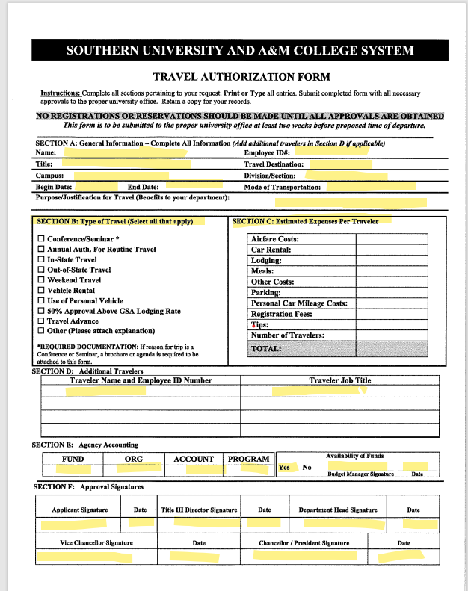
DocuSign Approval Process

Slide 8
DocuSign Approval Process
Form Submission:
  The Travel Authorization Form is completed by the traveler and submitted through Docusign.
Approval Workflow:
  The form must go through the following approval steps before reaching the Travel Specialist.
Title III Director Approval:
    The form is first sent to the Title III Director for review and signature.
Department Head Approval:
    After the Title III Director's approval, the form moves to the Department Head for review and signature.
Vice Chancellor Approval:
    Once approved by the Department Head, the form is sent to the Vice Chancellor for review and signature.
Chancellor Approval:
    Finally, the form is sent to the Chancellor for review and signature.

Slide 9
Travel Booking Process
Completion of Travel Authorization Form:
The form must be filled out through Docusign.
Required Information:
Include all highlighted information on the form.
Supporting Documents:
Attach any necessary supporting documents such as:
  Conference registration forms.
  Hotel details (if location differs from the event, etc.).
Traveler Information:
List ALL travelers for the trip.
Note: No additions can be made after the form is approved.
Adding Additional Travelers:
If additional travelers need to be added, a separate form must be submitted and approved.
Booking Travel:
The Travel Specialist will not begin booking any travel until the Travel Authorization Form is completed and approved via Docusign.

Slide 10
Travel Booking Process (Cont)
Once we receive your Travel Authorization form, the Travel Specialist will begin organizing your travel arrangements. You will receive confirmation for any booked transactions. If your trip requires additional information, the Travel Specialist may reach out to you for further details. Please respond promptly to any requests, as timely communication is crucial to ensure we meet all deadlines for your trip.
If your travel involves conference registration, you may be asked to provide your login credentials to complete the booking.
For accommodations, if you're staying at the conference hotel, your room will be reserved there. However, if you choose to book a room at a different hotel, your reservation must meet the approved rate criteria.
For further details, please refer to the link below.
Once your conference and hotel reservations are confirmed, you will receive an email notifying you that it is time to proceed with booking your airfare. After everything is booked, I will ensure that you have a copy of all confirmations, reservations, and, if applicable, your flight itinerary.
https://www.gsa.gov/travel/plan-book/per-diem-rates

Slide 11
Travel Booking Process (Cont)
Rental Car Process When Booking Travel:
If you are booking travel and a rental car is needed, please ensure that you attach a copy of your updated Defensive Driving Certificate and complete the Rental Car Request Form in DocuSign. Rental requests will not be processed without this documentation.
Details regarding the rental car policy can be found in PPM49 under §1504. Methods of Transportation, Section F: State-Rented Vehicles.

Slide 12
Required Documents
Below are examples of required documents for travel under PPM49:
Conference announcements or event details
Registration forms or confirmation of registration
Hotel booking receipts or confirmations
Airline tickets or flight itineraries
Passport or ID (if traveling internationally)
Payment receipts for conference fees or accommodation
Travel insurance documentation (if applicable)
Approval forms or travel authorization under PPM49
Any additional supporting documentation as specified by PPM49 guideline

Slide 13
Helpful Tips
Helpful tips when booking travel:
Keep lines of communication open with your Travel Specialist.
Provide all pertinent information that may be useful for your trip.
Submit all receipts promptly upon your return.
Ensure that office managers and/or administrative assistants are included in all correspondences.
All flights must be booked through Christopherson, and flights booked through another agency must be approved by the Office of State Travel.

Slide 14
Traveler Responsibility Reminder
Travelers are responsible for confirming all travel arrangements. Please ensure that hotel and flight reservations are finalized prior to departure.
Additionally, completed Travel Authorization Forms must be submitted within the following timeframes:
In-state travel: At least three weeks prior to the travel date
All other travel: No less than 30 days before the travel date
Timely submission is essential for proper processing and approval, and to ensure compliance with PPM49 and the Office of State Travel guidelines.

