Slide 1

PURCHASING

Slide 2


TRAINING OBJECTIVE
UNDERSTAND AND COMPLY WITH THE PURCHASING POLICY AND PROCEDURES

Slide 3

APPLICABILITY:
This training shall be applicable to all employees at SUNO who participate in the Purchasing process. Questions regarding the procedures should be directed to the Purchasing Department:
  Marilyn Manuel, Director of Purchasing – 504.286.5020
  Gwen Craft, Operations Officer – 504.286.5403
purchasing@suno.edu

Slide 4
MISSION
The mission of the Purchasing Department is to provide effective and efficient procurement services to support the University’s mission that is based on sound procurement practices in accordance with the university, executive policy and legislative mandates by the State of Louisiana and the Office of State Purchasing.
We provide education and training to SUNO employees on Procurement regulations imposed by the University.

Slide 5
PURPOSE:
This policy has been prepared to communicate policies and procedures to personnel involved in the procurement function. Effective administration of the Procurement function is essential to the Southern University campus to:
Provide for the purchase of goods, materials, and services in a timely manner, at a competitive price, of proper quality, and consistent with the needs of the campus;
To ensure the campus purchases are made in accordance with applicable federal, state, and local laws, regulations, codes, and ordinances;
To ensure prudent stewardship and accountability of campus resources; and
To ensure the best value is consistently obtained given the campus’s limited resources.

Slide 6
GENERAL PROCUREMENT GUIDELINES:
All procurement or purchases shall be made at Southern University using the following guidelines and directives:
Purchases up to $10,000.00 require (1) written quotation. No competitive bidding is required.
Purchases over $10,000.00 and up to $15,000.00 require three (3) written quotations.
Purchases over $15,000.00 and up to $29,999.99 require five (5) written quotations.
Purchases $30,000.00 or more require a sealed Bid to be sent to at least five (5) vendors and an advertisement in the newspaper and online through the State of Louisiana Purchasing Network Service (LaPAC) in accordance with R.S. 39:1594
States Contracts Purchases, no competitive prices are required. Prices are obtained by the State Office of Procurement, this eliminates the taking of bids or quotations or both, effecting considerate savings in time and money.

Slide 7
ACCOUNTABILITY GUIDELINES:
Requestors: Have the following responsibilities:
Submit the Purchase Requisition Form: Requestors must submit the purchase requisition form using DocuSign, ensuring all necessary steps for digital approval are followed. This should be done PIOR to any items sent or work started.
Include Supporting Documentation: The requisition should be accompanied by any relevant support documentation that provides context or further details about the requested purchase. This could include specifications or approval forms.
Provide a Detailed Description: The requisition must contain a completed description of the items being requested. This includes:
  Models Numbers: Specify the exact model numbers of products.
  Stock Numbers: Include any stock numbers that may identify the items.
  Brand Names: If applicable, mention the brand of the product.
  Colors and Sizes: Provide details on any required colors or sizes of the products, if relevant.
Complete vendor information, which includes:
  Vendor’s Name: The full legal name of the vendor or supplier providing the product or service.
  Vendor’s Address: The physical business address of the vendor, including street name, building or suite number (if applicable), city, and state.
  Vendor’s Zip Code: The postal code associated with the vendor’s address.
  Vendor’s Telephone Number: The contact telephone number for reaching the vendor or their representative.
  Vendor’s Fax Number (if applicable): The fax number for sending documents to the vendor, if relevant for communication.
  Vendor’s Email Address: The email address for contacting the vendor or their representative for any follow-ups or inquiries.
Include a W-9 form for all new vendors: This form is for tax reporting purposes and creating a vendor number in the Banner System.

Slide 8
ACCOUNTABILITY GUIDELINES:
Approvers additional responsibilities:
The immediate supervisor/approver must review the information entered and scanned into DocuSign, including documentation submitted by the requestor, prior to signing off on the transaction. If the information is not correct, the supervisor/approver should notate the transaction and electronically return it to the requestor for additional information and/or correction.
All requisitions must be approved in DocuSign by all approvers. A supervisor/approver/VC/Budget Manager/ Chancellor’s electronic approval certifies that the goods and/or services requested to be purchased are essential and necessary, appropriately budgeted for, and are in compliance with all requirements.

Slide 9
DOCUMENTATION AND RECONCILIATION GUIDELINES:
Documentation guidelines:
All purchases are required to have documentation supporting the business purpose of the transactions. Documentation summarizing the transactions and documenting that appropriate approvals occurred are also required. Section/agency heads, supervisors, approvers, and the Purchasing department are responsible for ensuring the following:
All required signatures: Ensure that all necessary signatures are obtained on the purchase requisition form and any related documents.
  Section/Agency Head’s signature: Ensures that the department leader has authorized the transaction.
  Supervisor’s signature: Ensures that supervisors have reviewed and approved the purchase request.
  Purchasing Department Approval: The Purchasing department must sign off to confirm the purchase is in compliance with procurement policies and procedures.
Correct needed information: Double-check that all required fields, such as vendor information, item details, and approvals, are filled out correctly before submissions.

Slide 10
WORKFLOW PROCESS
Need to make a Purchase
Requisition is completed in DocuSign by Requestor
All Required documentation is uploaded
Email in sent to Supervisor/ Approver
Supervisor/ Approver needs to REVIEW, SIGN or REJECT
Email is sent to VC or Department
VC needs to REVIEW, SIGN or REJECT
Email is sent to Budget Manager
Budget Manager needs to REVIEW, SIGN or REJECT
If Grant funded, email sent to VC Grants & Sponsored Programs
VCGSP needs to REVIEW, SIGN or REJECT
Email is sent to VC for Finance and Admin
VC needs to REVIEW, SIGN or REJECT
Email is sent to Chancellor
Chancellor needs to REVIEW, SIGN or REJECT

Slide 11
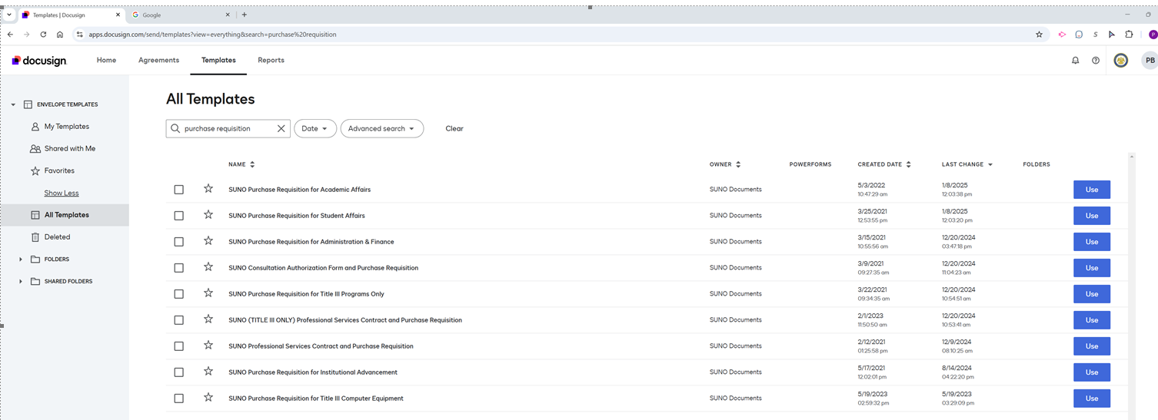
SUNO DocuSign-Purchase Order Requisition Request
If you don’t have a DocuSign login, contact ITC for your set-up

Slide 13
QUESTIONS

