Slide 1

Accounts Payable

Slide 2

TRAINING OBJECTIVE
UNDERSTAND AND COMPLY WITH THE ACCOUNTS PAYABLE POLICY AND PROCEDURES

Slide 3

APPLICABILITY:
This training shall be applicable to all employees at SUNO who participate in the A/P process. Questions regarding the procedures should be directed to the SUNO Chief Disbursement Officer:
Shantel Lee-Hubbard
      286-5004
accountspayable@suno.edu

Slide 4
MISSION
The mission of the Accounts Payable Department is to process all disbursement requests other than payroll and student financial aid refunds in compliance with State and University regulations, to provide timely and accurate reimbursements to employees and payments non employees for goods and services furnished to the University by companies and organizations. We provide education and training to SUNO employees on the A/P regulations imposed by the University.

Slide 5
PURPOSE:
The purpose of this training is to provide guidance University’s accounts payable procedures to ensure compliance with University and State requirements, provide a procedural framework for employees and vendors who engage in financial transactions with the university business, and outline fiscally responsible spending practices.
All University employees are required to exert responsibility when procuring goods and services for the university and to adhere to requirements established by the Southern University System.

Slide 6
GENERAL GUIDELINES:
Checks and e-payments should be prepared based on the determination that the transaction is valid and is in accordance with the following university procedures:
A determination that the transaction is valid should be accomplished by reviewing the following supporting documentation as applicable:
• Invoices (together with purchase orders, as applicable)
• Approved Departmental Invoice forms
• Approved Travel Reimbursement Forms
All supporting documentation will be reviewed by the Chief Disbursement Officer to confirm adherence to policies and procedures
Checks and e-payments should be prepared by persons other than those who initiate or approve any documents that give rise to disbursements. Once an invoice has been approved and processed into the AP module of the Banner system, a payment will be processed.

Slide 7
ACCOUNTABILITY GUIDELINES:
Requestors: Have the following responsibilities:
Obtain, review and understand the State and Agency procurement policies.
Maintain knowledge and comply with all applicable current purchasing policies, rules and regulations, mandates, Louisiana Statutes, Executive Orders, State Liability Travel Policy, internal agency policies and procedures and/or PPM #49 as applicable.
Complete, route and obtain approved departmental invoices, purchase orders, travel authorizations, with required documentation
Ensure the use of online accounts Amazon, EBay, PayPal, etc. are not combined with personal accounts.

Slide 8
ACCOUNTABILITY GUIDELINES:
Approvers additional responsibilities:
The immediate supervisor/approver must review the information entered and scanned into DocuSign, including documentation submitted by the requestor, prior to signing off on the transaction. If the information is not correct, the supervisor/approver should notate the transaction and electronically return it to the requestor for additional information and/or correction.
All transactions must be approved in DocuSign by all approvers. A supervisor/approver/VC/Budget Manager’s electronic approval certifies that the goods and/or services purchased are essential and necessary, appropriately budgeted for, and are in compliance with all requirements herein.

Slide 9
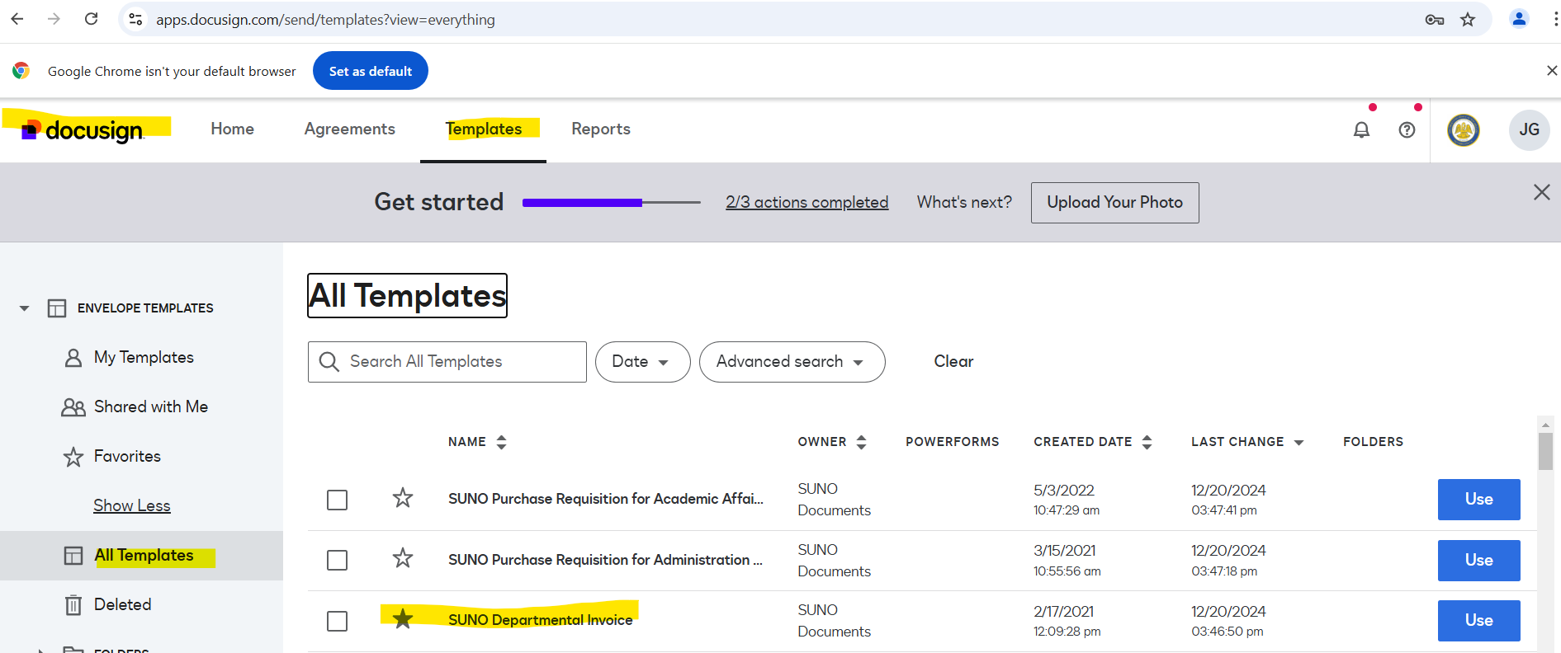
SUNO DocuSign-Departmental Invoice

Slide 10
DOCUMENTATION AND RECONCILIATION GUIDELINES:
Documentation guidelines:
All purchases are required to have documentation supporting the business purpose of the transactions. Documentation summarizing the transactions and documenting that appropriate approvals occurred are also required. Section/agency heads, supervisors, approvers and the Chief Disbursement Officer is responsible for ensuring the following:
All required signatures
Inventory type purchases [electronic, etc…] should have “received by” and a signature on packing slip or other shipping documentation to ensure that the purchase arrived and is accounted for at the agency.
Documentation of approval must be accomplished by a signature electronically online by signing off on the transaction via DocuSign. For items purchased over the counter, obtain the customer copy of the receipt. When ordering by computer, a packing list or similar document must be obtained.
For items such as registrations, where the vendor does not normally generate a receipt or packing slip, a copy of the ordering document may be used.
For internet purchases, the print out of the order confirmation showing the details, or the printout of the order details, or the shipping document if it shows what was purchased, the quantity and the price paid will suffice for the itemized receipts.

Slide 11
DOCUMENTATION AND RECONCILIATION GUIDELINES(cont’d):
Electronic receipts are allowed if they are un-editable and are maintained in compliance with the agency retention policy.
If a receipt is not furnished by the merchant (as may be the case with a Internet order), documentation such as an order confirmation, packing slip, or invoice, etc. should be obtained and should contain an itemized and detailed description of the purchase. All receipts must give an itemized and detailed description of the purchase and must include at a minimum:
    Merchant Name
    Date of Purchase
    Description (a receipt description, which only states “Miscellaneous”, or “Merchandise”, or only includes a vendor’s stock or item number, is not acceptable).
    Unit price and quantity
    Transaction total
If the documentation for a transaction has been lost, it is the ’s requestor’s responsibility to obtain a duplicate from the vendor. If a duplicate cannot be obtained, the requestor should complete the Receipt Replacement Form to serve as the documentation. The Receipt Replacement Form should contain the itemized information for the transaction, and describe the requestor’s attempt to obtain a duplicate from the vendor. Receipt Replacement Forms may NOT be used excessively. Excessive use of the form is identified as once per quarter and more than four times in one fiscal year.

Slide 12
REQUISITON, DEPARTMENTAL INVOICE OR TRAVEL REIMBURSEMENT
Which form to use:
Requisition: used within the university to formally request goods or services from suppliers or vendors. This internal document initiates the procurement process, ensuring that all necessary approvals are obtained before any purchase is made
Departmental Invoice: Is an internal billing process used for employee travel reimbursements, student stipends, student travel advancements paid to an employee. NOT USED FOR VENDOR PAYMENTS.
Travel Reimbursement: reimbursements for approved expenses incurred while traveling for work, (i.e. conferences, client meetings, training) requires you to itemize your travel costs such as meals and transportation on the BA-12 form. When incurring work related expenses, paid by the employee during university travel, you should complete and route for approval a departmental invoice form with a completed travel expense account form and a copy of your approved travel authorization form. Reimbursements must be submitted within 30 days of trip’s end date.

Slide 13
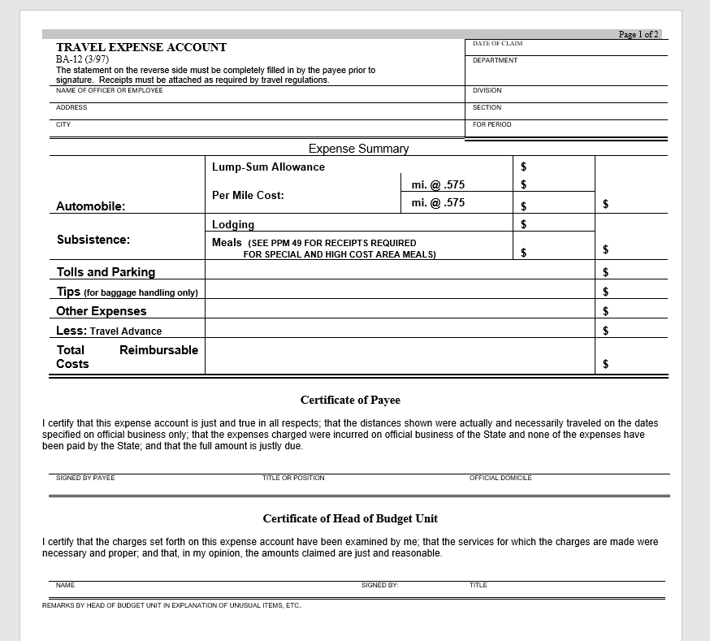
TRAVEL REIMBURSEMENT (BA-12 Form)

Slide 14
Student Stipends
Departmental Invoice Form - completed
  Include documentation (letter) explaining purpose of stipend, grantor, student’s name, student’s U#, term date, and stipend total
    Route for approval and signatures
NOTE: SCHOLARSHIPS SHOULD BE ROUTED TO FINANCIAL

Slide 15
WORKFLOW PROCESS
FOR
ACCOUNTS PAYABLE
Requisition and Purchase Order is Received
AP is required to get an invoice preferably by email/mail
AP reviews documentation and verify against requisition and purchase order
Once information is verified AP can start processing vendors payment
Once processed by AP all documents are review and approved by comptroller
Departmental Invoice is Received via email
Reviewed to make sure all documentation is received
If any documentation is missing AP would send an email to the requestor
Once all documentation is received AP will start processing vendors payment
Once processed by AP all documents is review and approved by comptroller
Employee Travel Reimbursement completed on Departmental Invoice
Reviewed to make sure all documentation is received **FOLLOW THE PPM-49**
If any documentation is missing AP would send an email to the requestor
Once all documentation is received AP will start processing vendors payment
Once processed by AP all documents is review and approved by comptroller

Slide 16
QUESTIONS

